Slide 1

T1A3 PORTFOLIO
A WEBSITE STORY BY DANIEL KIM ©

Slide 2
FEATURES
About me
Portfolio/Projects
Blog Posts
CONTACT page
Link to all relevant socials, using their respective logo’s as buttons.

Slide 3
FEATURES
Screen shot of nav bar
Screen shot of DK logo: clicking on logo will redirect to home/ landing page
Screen shot of socials buttons

Slide 4
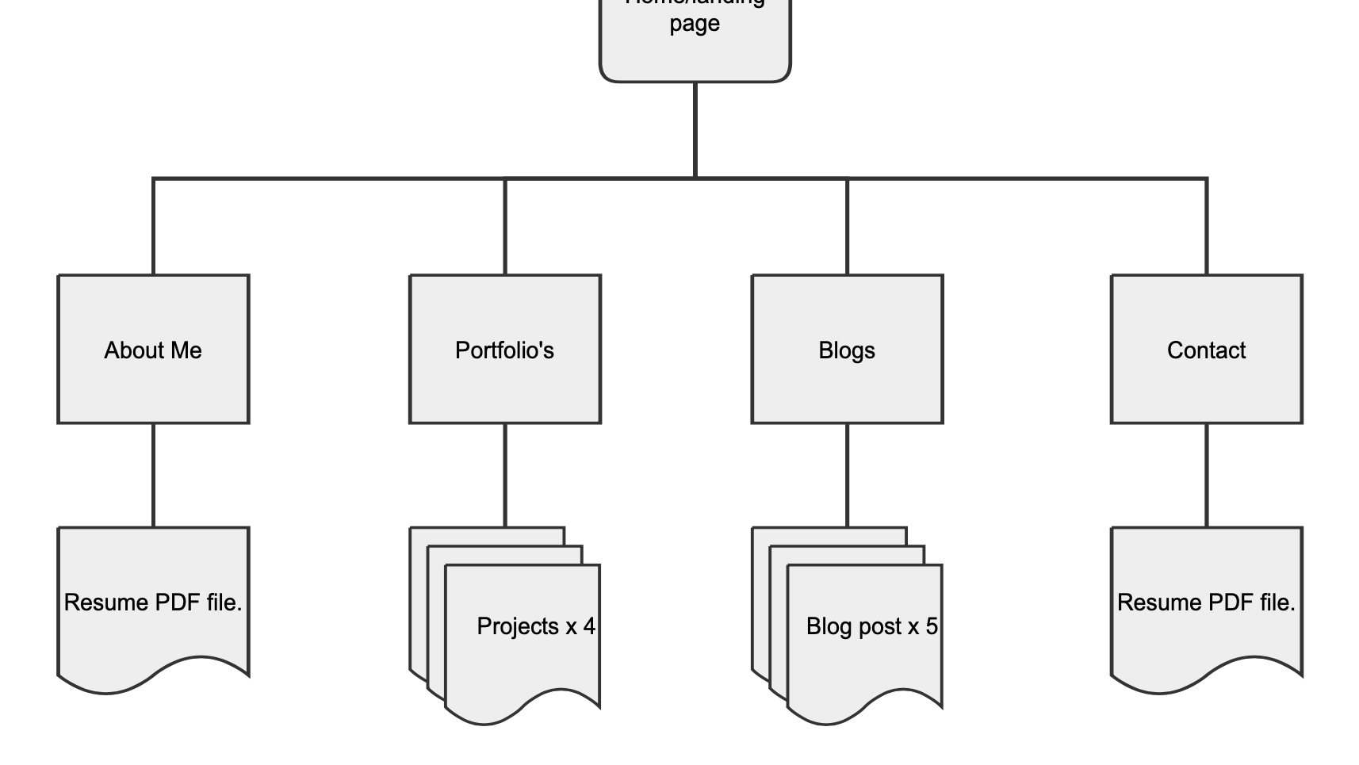
SITEMAP
PORTFOLIO WEBSITE

Slide 5
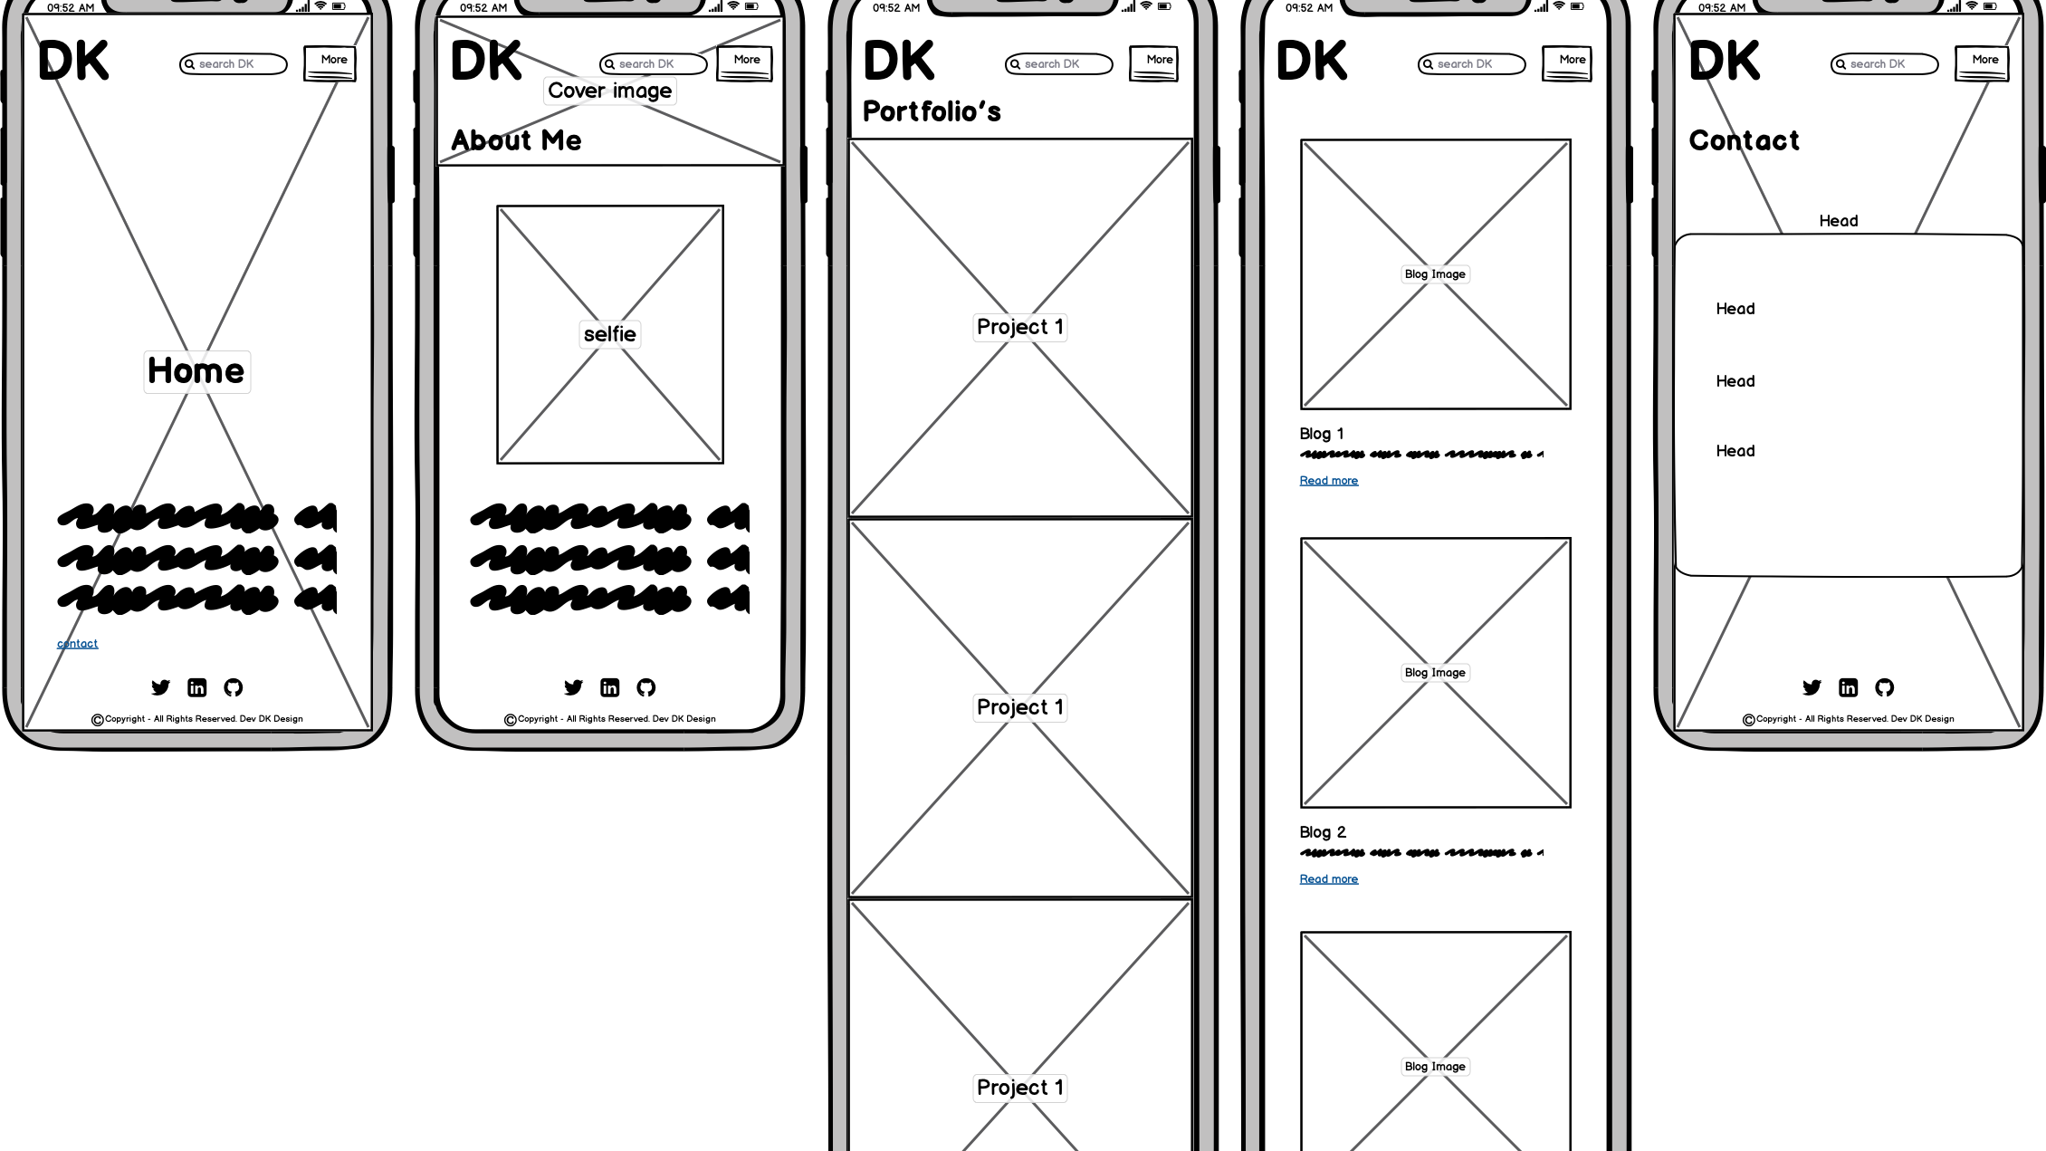
WIREFRAME-MOBILE

Slide 6
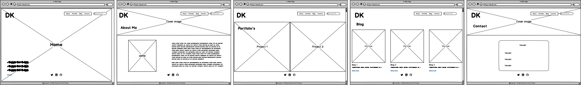
WIREFRAMES - DESKTOP

Slide 7
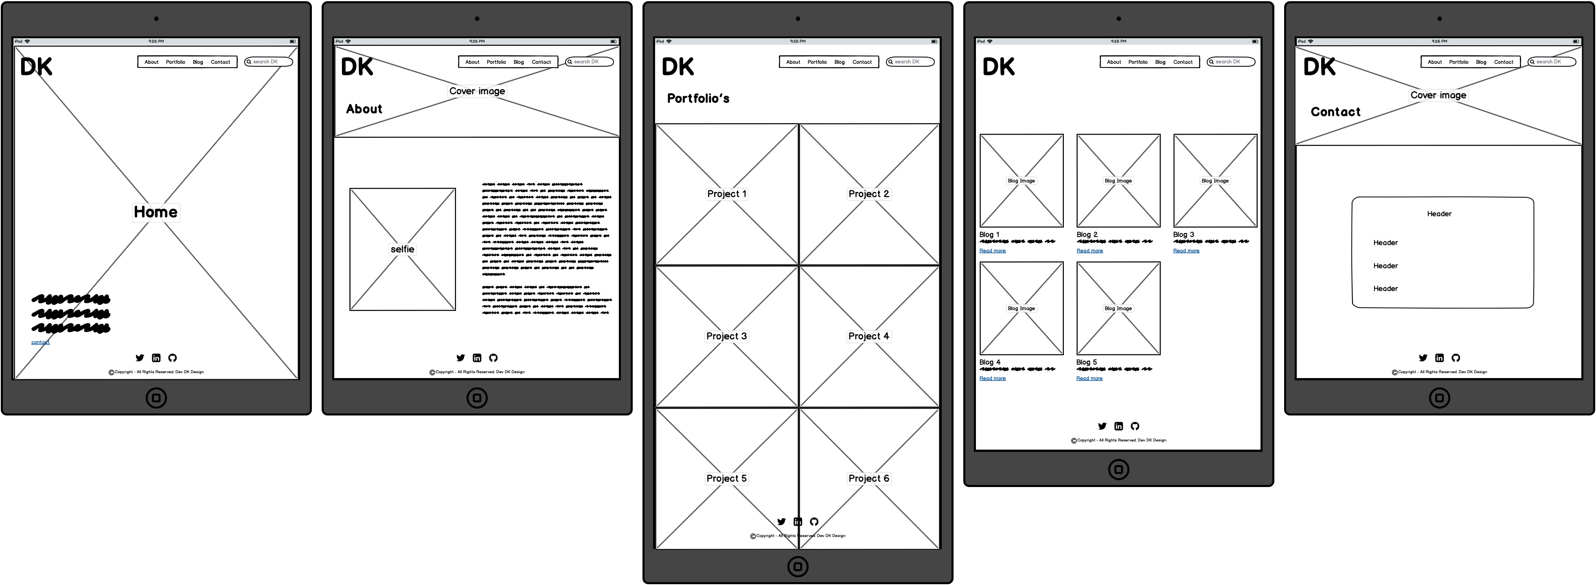
WIREFRAME - TABLETS

Slide 8
DESIGN PROCESS
PINTEREST – MOOD BOARD
DRIBBLE
PAST STUDENTS

Slide 9
REASONS
SIMPLE TO CODE (HOPEFULLY)
CLEAN/SIMPLE = PLEASANT UX
AIMING FOR ZERO LAG

Slide 10
COMPONENTS
WHITE SPACE – LOTS OF IT.
NAVIGATION BAR
MULTIPLE PAGES
WELL SELECTED TYPOGRAPHY FONTS
HIGH-RES IMAGES
STRATEGICALLY PLACED TEXT AND COVER PHOTOS

Slide 11
REVIEW
GETTING TOO CAUGHT UP IN THE DESIGN, RATHER THAN JUST FULFILLING THE ASSIGNMENT REQUIREMENTS.
BALANCING TIME BUDGET
REALLY ENJOYED GAINING INSPIRATION FROM PROFFESSIONAL WEBSITES AND THEN USING WIRIFY ON THEM.

